Slide 1

Statistics for CSAI II
11 – Mixed models, Multilevel models, random coefficient regression models, hierarchical linear modeling…
Travis J. Wiltshire |

Slide 2
Modules
Introduction and Probability
Sampling Theory
Revisiting Hypothesis Testing & Intro to Correlation
Correlation
Intro to Regression
More Regression Centering and Checking Assumptions
Multiple Regression and Assumptions
Interactions
Multiple Regression with Categories
Multiple Regression with Polynomials
Mixed Models
Growth Curve Analysis
2

Slide 3
Outline
What is it?
Random Intercepts
Random Slopes
Assumptions
2

Slide 4
Multiple and Mixed Model Regression
Y_{si} = b_{0s} + b_{1s}X_{i} + …b_{ns}X_{n}+ ε_{si}
^{b}0s ^{= b}0 ^{+ S}0s Random Intercept
Y = b + b X + …b X + ε
i 0 1 1 n n i
b_{1s} = b₁ + S_{1s}
One dependent variable Y predicted from a set of independent variables (X1, X2 ….Xk)
One regression coefficient for each independent variable
R²: proportion of variation in dependent variable Y predictable by set of independent variables (X’s)
Random Slopes
Dependent variable Y is predicted from set of fixed and random effects of independent variables
Random effects capture variation due to differences between subjects/items/etc.
Can model data that is hierarchical/nested/clustered
- Groups, cohorts, schools, organizations, hospitals, etc.

Slide 5
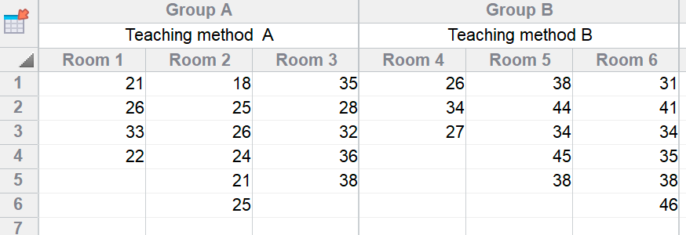
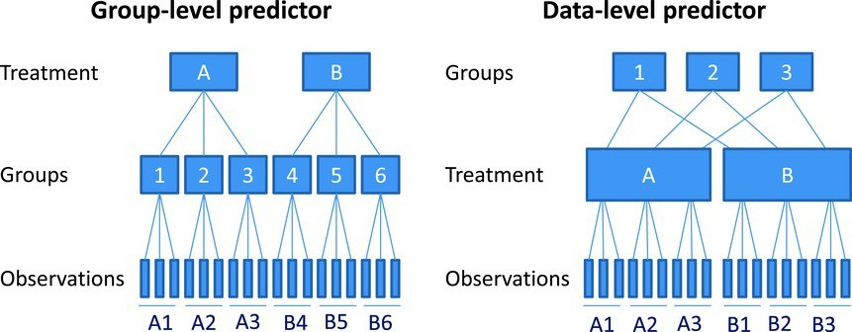
Data Types
Nested Data
Repeated Measures Data
Longitudinal Data

Slide 6
Why should we use this?
We can ‘ignore’ some of the assumptions of regression
Homogeneity of regression slopes
  Model the variability in regression slopes
Assumption of independence
  You can model the relationships between cases
  Regression for repeated observations
Missing data
  MLMs can cope with missing data

Slide 7
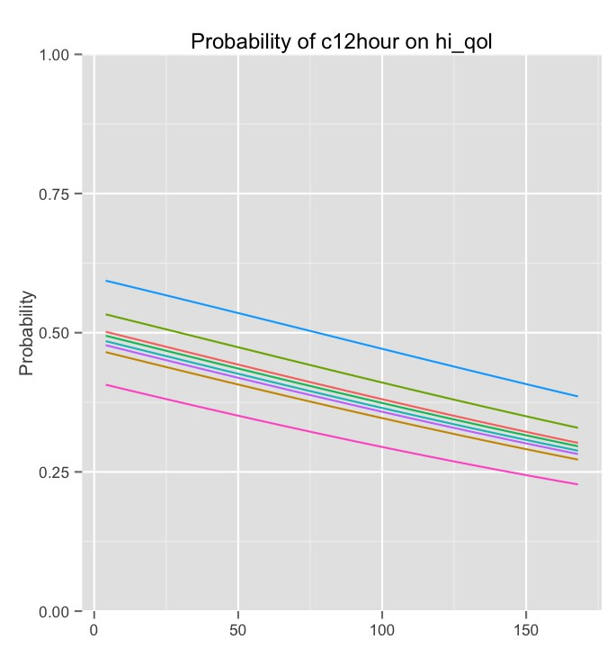
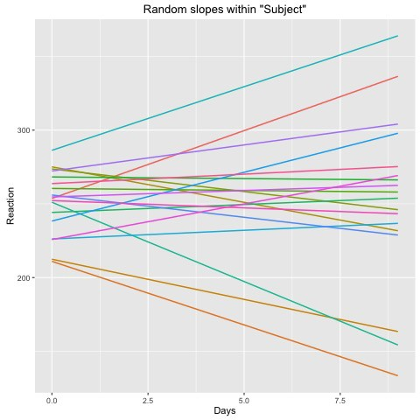

Fixed effects vs random effects
Intercepts and slopes can be fixed or random
  In OLS regression they are fixed
Fixed coefficients
  Intercepts/slopes are assumed to be the same across different contexts
Random coefficients
  Intercepts/slopes are allowed to vary across different contexts
  Require

Slide 8
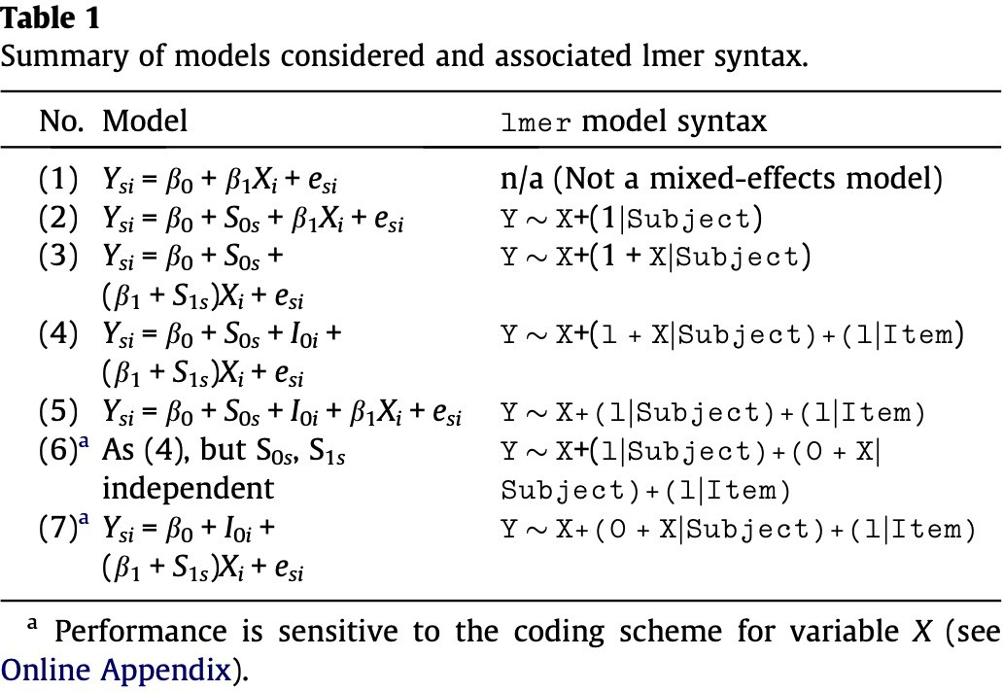
Barr, D. J., Levy, R., Scheepers, C., & Tily, H. J. (2013). Random effects structure for confirmatory hypothesis testing: Keep it maximal. Journal of memory and language, 68(3), 255-278.
https://bookdown.org/steve_midway/DAR/random-effects.html

Slide 9
Pros and cons of mixed models
Computational complexity
  Can be difficult to specify
  No fitting using least squares regression possible
  May result in convergence issues
Interpretation issues
  Computation of p-values not straightforward
Can account for nested or repeated measures data
Can handle missing measurements
Illuminating our error term ε
  These additional terms account for non-independence
  And things that were previously all relegated to ‘error’ now can become random effects
  E.g., differences due to subjects or certain question items, schools, groups, etc

Slide 10
Changes to R² in mixed effects modeling
R² conditional
  Includes variance explained by fixed and random effects
R² marginal
  Includes only variance explained by fixed effects
Nakagawa, S., Johnson, P. C. D., & Schielzeth, H. (2017). The coefficient of determination R2 and intra-class correlation coefficient from generalized linear mixed-effects models revisited and expanded. Journal of The Royal Society Interface, 14(134), 20170213. doi: 10.1098/rsif.2017.0213

Slide 11
Running the model in R with random intercepts
Install the lme4 package and lmerTest package
Using the lmer() function we specify our model with random intercept as follows:
outcome ~ pred1 + (1|pred2)
Where pred2 has multiple observations associated with some higher level group (e.g., participant, school, team)
Pred2 also isn’t necessarily something we are interested in using as a predictor, but we know it is having some influence on our outcome and we want to ‘control’ for that

Slide 12
Run a mixed model with random intercepts
Install and load the lme4 and lmerTest packages
Load the politeness data (it is on Canvas)
Check out the politeness data set (get a summary, make some plots, etc.)
Make a prediction about the relationship between attitude and vocal frequency
Run a mixed effects model to predict vocal frequency from attitude while allowing random intercepts for subject and scenario
- Remember to add these to the equation (1|pred)
Get R² values using performance() function
Generate and inspect the random intercepts using coef(yourmodelhere)
Interpret the output
Bonus: use parameters::model_parameters() function to get standardized coefficients

Slide 13
Interpreting Random Effects and Intraclass Correlation
Intraclass correlation
  Ratio of the random intercept variance
(between-person) to the total variance,
defined as the sum of the random intercept
variance and residual variance (between + within).
  Coefficient of observations in the same correlation cluster
  Can tell you:
  If mixed model is even necessary (if ICC is near 0, maybe not)
  How much variation is explained due to
clustering/grouping variable(s) – i.e., the random effects
  Compare how ICC changes with different changes to model
Random effects
  Variance tells you how much variability
between individuals in a group is explained relative to residual
  SD tells you about between-subject differences within the group
  Corr – is correlation between slope and intercept

Slide 14
Comparing Models
AIC : Lower value is better model
BIC : Lower value is better model
Loglikelihood : Higher is better model
- Model 1 LL – Model 2 LL

Slide 15
Repeat the same mixed model with random intercepts and new predictor
Make a prediction about the relationship between attitude and vocal frequency and gender and vocal frequency
Run a mixed effects model to predict vocal frequency from attitude and gender while allowing random intercepts for subject and scenario
- Remember to add these to the equation (1|pred)
Get R² values using performance() function
Generate the random intercepts using coef(yourmodelhere)
Compare the 2 models using AIC, BIC, -2LL, ANOVA
Interpret the output
Bonus: use parameters::model_parameters() function to get standardized coefficients

Slide 16
Running the model in R with random intercepts and slopes
Using the lmer() function we specify our model outcome ~ pred + (1+pred|pred2)
Telling R to expect the slope to vary for the fixed effect (pred) as a function of pred2
15

Slide 17
Run a mixed model with random intercepts and slopes
Run a mixed effects model to predict vocal frequency from attitude and gender while allowing random intercepts for subject and scenario and random slopes based on attitude
- Remember to add these to the equation (1+pred|pred2)
Get R² values using performance() function
Generate the random intercepts and slopes using coef(yourmodelhere)
Compare the 2 models
Interpret the output

Slide 18
Should it be fixed or random?
Rules of thumb for random effects
  Include random intercepts for all ‘control’ variables (subject ID, school, observation number, teamID, etc. )
  Only include random slopes that are interesting to test
Maximal model with step down (to reduce Type 1 error rate)
  Maximal possible random slopes and intercepts if possible
  See also examples here: http://www.alexanderdemos.org/Mixed7.html#1_random_items_(st imulus)
Barr, D. J., Levy, R., Scheepers, C., & Tily, H. J. (2013). Random effects structure for confirmatory hypothesis testing: Keep it maximal. Journal of memory and language, 68(3), 255-278.

Slide 19
Assumptions
Linearity and homoscedasticity of the model
Normality of residuals
Multicollinearity
Influential data points
  cf. leverage and influence: http://omaymas.github.io/InfluenceAnalysis/
Independence (What?)
  You could accidentally leave out an important dependency in your model.

Slide 20
Check your assumptions for mod.3
Linearity and homoscedasticity of the model
Normality of residuals
Influential data points
  Try plot(hatvalues(mod.3)) and see if there is a cut-off you would use to exclude the potentially influential values from the model
  Figure out a way to find that/those values from the dataset (in a new object) and re-run model without these points

Slide 21
Some example write ups of mixed models
Wiltshire, T. J., Euler, M. J., McKinney, T. L., & Butner, J. E. (2017). Changes in Dimensionality and Fractal Scaling Suggest Soft-Assembled Dynamics in Human EEG. Frontiers in physiology, 8, 633.
  https://www.ncbi.nlm.nih.gov/pmc/articles/PMC5585189/pdf/fphys-08-00633.pdf
Paxton, A., Abney, D. H., Kello, C. T., & Dale, R. K. (2014, January). Network analysis of multimodal, multiscale coordination in dyadic problem solving. In Proceedings of the Annual Meeting of the Cognitive Science Society (Vol. 36, No. 36).
  https://cloudfront.escholarship.org/dist/prd/content/qt7xz2z06w/qt7xz2z06w.pdf
Baayen, R. H., Davidson, D. J., & Bates, D. M. (2008). Mixed-effects modeling with crossed random effects for subjects and items. Journal of memory and language, 59(4), 390-412.
  https://www.sciencedirect.com/science/article/pii/S0749596X07001398
Peugh, J. L. (2010). A practical guide to multilevel modeling. Journal of school psychology, 48(1), 85-112.
  https://www.sciencedirect.com/science/article/pii/S0022440509000545?via%3Dihub

Slide 22
Some additional resources
Meteyard, L., & Davies, R. A. (2020). Best practice guidance for linear mixed-effects models in psychological science. Journal of Memory and Language, 112, 104092.
https://seantrott.github.io/mixed_models_R/#Why_use_mixed_mode ls
https://rpsychologist.com/r-guide-longitudinal-lme-lmer
http://www.floppybunny.org/robin/web/virtualclassroom/stats/statisti cs2/articles/mixed_models/Introduction-to-LMER.pdf
https://freshbiostats.wordpress.com/2013/07/28/mixed-models-in-r-lme4-nlme-both/
http://davidakenny.net/papers/k&h/MLM_R.pdf
Maximum Likelihood Estimation: https://youtu.be/XepXtl9YKwc
McNeish, D., Stapleton, L. M., & Silverman, R. D. (2017). On the
unnecessary ubiquity of hierarchical linear modeling. Psychological methods, 22(1), 114.

Slide 23
Preparing for Module 12: Growth Curve Modeling
1. Read excerpts from Mirman - Growth Curve Analysis and Visualization Using R

Slide 24
Thanks! See you next week! Questions?
Material partially from Bodo Winter Tutorial

